Slide 1
Lesson 10 – Exceptions

Slide 2
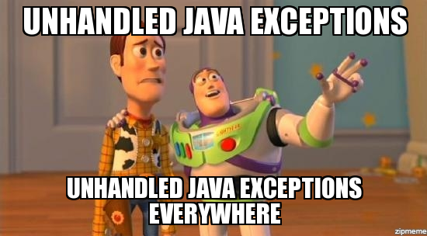
Lesson goals
Exceptions
Assertions

Slide 3
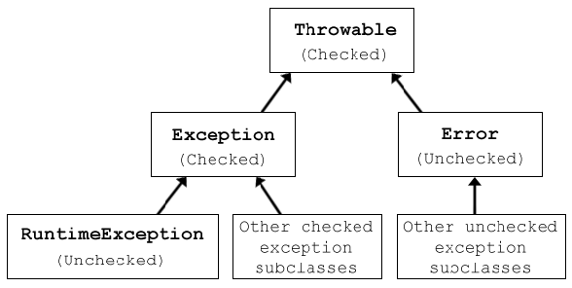
Exception hierarchy

Slide 4
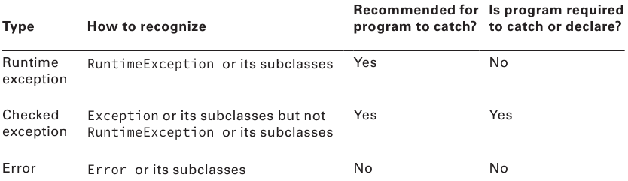
Exception types
Notes:
java.lang.Exception - Errors that are expected. In some cases, the program can recover itself from them (IOException, ParseException, SQLException)
java.lang.RuntimeException - Unexpected errors generated at runtime. In most cases, the program cannot recover itself from them (ArithmeticException, ClassCastException, NullPointerException)
java.lang.Error - Represents serious problems or abnormal conditions that a program should not deal with. Some examples are: AssertionError, IOError, LinkageError, VirtualMachineError

Slide 5
Common exceptions
ArithmeticException
ArrayIndexOutOfBoundsException
ClassCastException
IllegalArgumentException
NullPointerException
…

Slide 6
Exception population
public User auth(String username) { throw new UserNotFoundException(); }

Slide 7
Exception handling: Declare
public static Date parse(String date) throws ParseException { SimpleDateFormat sdf = new SimpleDateFormat("MM/dd"); return sdf.parse(date); }
Use throws only for checked exceptions

Slide 8
Exception handling: Catch
public static Date parse(String date) { SimpleDateFormat sdf = new SimpleDateFormat("MM/dd"); try { return sdf.parse(date); } catch (ParseException e) { log("Date parse failed", e); return null; } }

Slide 9
Unreachable exception handler
try { System.out.println("Hello"); } catch (SQLException e) { // Compile-time error
logger.error("SQL Exception caught", e); }

Slide 10
Exception catch blocks order
try { SimpleDateFormat sdf = new SimpleDateFormat("MM/dd"); Date date = sdf.parse("01-10"); System.out.println(date); } catch (ParseException e) { log(“Date parse failed”, e); } catch (Exception e) { log(“Unexpected error”, e);
}

Slide 11
Default exception handler
Prints out exception description;
Prints the stack-trace;
Causes the program to terminate.

Slide 12
Using Multi-catch
try { Path path = Paths.get("dolphinsBorn.txt"); String text = new String(Files.readAllBytes(path)); LocalDate date = LocalDate.parse(text); System.out.println(date); } catch (DateTimeParseException e) {
throw new RuntimeException(e); } catch (IOException e) {
throw new RuntimeException(e); }

Slide 13
Using Multi-catch
try { Path path = Paths.get("dolphinsBorn.txt"); String text = new String(Files.readAllBytes(path)); LocalDate date = LocalDate.parse(text); System.out.println(date);
} catch (DateTimeParseException | IOException e) { throw new RuntimeException(e); }

Slide 14
Issues?
try { mightThrow(); } catch(FileNotFoundException | IllegalStateException e) {
e = new RuntimeException(); } catch(InputMismatchException e | MissingResourceException e) {
} catch(FileNotFoundException | IOException e) { } catch(SQLException e){ } catch(FileNotFoundException | IllegalArgumentException e) {
} catch(Exception e) { } catch(IOException e) { }
private void mightThrow() throws DateTimeParseException, IOException {…}

Slide 15
Issues!
try { mightThrow(); } catch(FileNotFoundException | IllegalStateException e) {
e = new RuntimeException(); // in multicatch variable is effectively final
} catch(InputMismatchException e | MissingResourceException e) { // extra variable name
} catch(FileNotFoundException | IOException e) { // different hierarchy
} catch(SQLException e){ // cannot catch SQLException because nothing can potentially throw one } catch(FileNotFoundException | IllegalArgumentException e) { // cannot catch FileNotFoundException because was already caught on first catch } catch(Exception e) { // more general superclasses must be caught after their subclasses. } catch(IOException e) { // more general superclasses must be caught after their subclasses. }
private void mightThrow() throws DateTimeParseException, IOException {…}

Slide 16
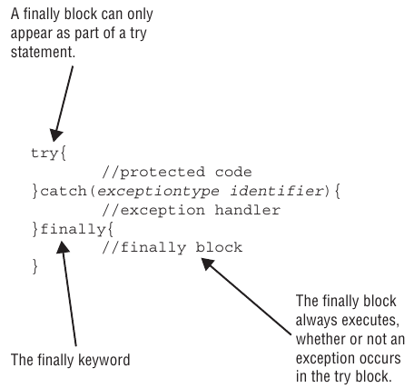
Try catch finally statement

Slide 17
Try catch finally statement
Open resource
Try do something with resource and other
Catch any errors
Finally close resource

Slide 18
Try catch finally statement
public void oldSchool(Path path1, Path path2) { BufferedReader in = null; BufferedWriter out = null; try { in = Files.newBufferedReader(path1) out = Files.newBufferedWriter(path2);
out.write(in.readLine()); } catch (IOException e) { log(e); } finally { try { if (in != null) in.close(); } catch (IOException e) { log(e);
} try { if (out != null) out.close(); } catch (IOException e) { log(e);
} } }

Slide 19
Try-With-Resources
public void newSchool(Path path1, Path path2) { try (
BufferedReader in = Files.newBufferedReader(path1); BufferedWriter out = Files.newBufferedWriter(path2)
) { out.write(in.readLine()); } catch (IOException e) { log(e); } }

Slide 20
Try-With-Resources: Suppressed Exceptions
Java treats the first exception as the primary one and tacks on any that come up while automatically closing
Suppressed exceptions apply only to exceptions thrown in the try clause

Slide 21
Try-With-Resources: Suppressed Exceptions
class Bottle implements AutoCloseable { private final int maxVolume; private int currentVolume;
// constructor void addWater(int volumeToAdd) { int probableVolume = currentVolume + volumeToAdd; if (probableVolume > maxVolume) { this.currentVolume = maxVolume; System.out.println("Bottle is full"); throw new IllegalArgumentException("Bottle can not contain more water, it is full!"); } this.currentVolume = probableVolume; System.out.println("Added " + volumeToAdd + ". Current value " + this.currentVolume); } @Override public void close() throws IOException { throw new IOException("Bottle can not be closed, no cap!"); } }

Slide 22
Try-With-Resources: Suppressed Exceptions
try (Bottle bottle = new Bottle()){ bottle.addWater(1); bottle.addWater(1); bottle.addWater(1); bottle.addWater(1); } catch (IOException e) { log("Something happened while adding water: " + e.getMessage()); }
Created bottle with max volume 3
Added 1. Current value 1
Added 1. Current value 2
Added 1. Current value 3
Bottle is full
Exception in thread "main" java.lang.IllegalArgumentException: Bottle can not contain more water, it is full!
at Bottle.addWater(scratch_1.java:17)
at Main.main(scratch_1.java:36)
Suppressed: java.io.IOException: Bottle can not be closed, no cap!
at Bottle.close(scratch_1.java:26)
at Main.main(scratch_1.java:37)

Slide 23
Custom exceptions
class CannotSwimException extends Exception { } class DangerInTheWater extends RuntimeException { public DangerInTheWater() { } public DangerInTheWater(String message) { super(message); } public DangerInTheWater(String message, Throwable cause) { super(message, cause); } }
class SharkInTheWaterException extends DangerInTheWater { }

Slide 24
Stack trace
throw new DangerInTheWater();
Exception in thread "main" DangerInTheWater
at ExceptionExample.main(ExceptionExample.java:3)

Slide 25
Stack trace
throw new DangerInTheWater("broken fin");
Exception in thread "main" DangerInTheWater: broken fin
at ExceptionExample.main(ExceptionExample.java:3)

Slide 26
Stack trace
throw new DangerInTheWater("broken fin",
new RuntimeException("Can not access water")
);
Exception in thread "main" DangerInTheWater: broken fin
at ExceptionExample.main(ExceptionExample.java:3)
Caused by: java.lang.RuntimeException: Can not access water
... 1 more

Slide 27
Assertion
An assertion is a Boolean expression that you place at a point in your code where you expect something to be true
An assertion allows for detecting defects in the code
The syntax for an assert statement has two forms:
assert boolean_expression; assert boolean_expression: "error_message";
Assertions are DISABLED by default.

Slide 28
Assertion
public class AssertionExample { public static void main(String[] args) { int result = calc(0,2,3); assert result > 0 : "Result should be positive"; } private static int calc(int a, int b, int c) { return a * b * c; } }
Exception in thread "main" java.lang.AssertionError: Result should be positive
at AssertionExample.main(AssertionExample.java:4)

Slide 29
Homework
Add new codec. “UkrainianEnglish” with ability to translate words (1000 the most common English words). For example:
UkrainianToEnglish::encode(“Я люблю тебе!”) - “I love you!”
UkrainianToEnglish::encode(“Я люблю Джава!”) – “Illegal input. Words [Джава] are absent in UA to EN dictionary”
UkrainianToEnglish::decode(“I love you!”) - “Я люблю тебе!”
UkrainianToEnglish:: decode(“I love Java!”) – “Illegal input. Words [Java] are absent in EN to UA dictionary”
2. Implement hierarchy of exceptions. Update “Coding” application to return errors and properly handle them in consumers:
IllegalCharacterException - when unsupported data (symbol/word) passed as input to codec(s);
CodecUnsupportedException - when unsupported codec selected;
EmptyHistoryException - when the most popular codec cannot be found because no coding operations done yet;
OperationUnsupportedException – when unsupported operation selected;

Slide 30
Links
Exceptions (Oracle)
Baeldung

Slide 31
Thanks!
Any Questions?
Or find us in Slack:
@Yaroslav Brahinets
@Vasya Rudas
@Oleksandr Kucher

